Slide 1
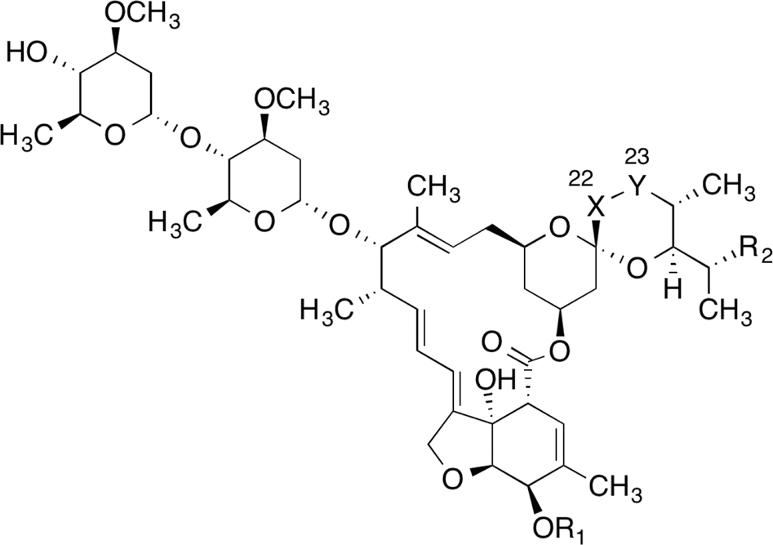
IVERMECTIN: Situation in LATAM 3 – 15 October

Slide 2
IVERMECTIN ONLINE MEDIA IMPACTS 3 to 15 October
Total impacts: 1.435
Reach: 17 million people (↓15 %)
Monitored countries:
Argentina
Bolivia
Brazil
Chile
Colombia
Dominican Republic
Mexico
Peru
Venezuela

Slide 3
GENERAL ASPECTS
Political leaders from several countries claim to have used ivermectin to treat themselves against COVID-19: Honduras, Brazil, Colombia.
Peru (451 articles)
Controversy over drugs against COVID-19: on October 13, the ministry announces withdrawal of hydroxychloroquine, ivermectin and azithromycin from the treatment guide for hospitalized COVID patients. On October 15, the ministry declares that these drugs will still be used to treat ambulatory cases.
Prior to that, on October 12, the director of Essalud's Institute for the Evaluation of Technology in Health and Research, Patricia Pimentel, lost her management position after publishing a study on the effectiveness of hydroxychloroquine, azithromycin and ivermectin in the treatment of patients with COVID-19.
Argentina (468 articles)
The press is still echoing the favorable results in the study of the ivermectin against COVID-19.
Argentina is administering ivermectin to urgent cases of COVID-19 in hospitals, according to declarations from the Science Minister.
San Salvador De Jujuy, Argentina, is experiencing a decline in COVID-19 cases. The coordinator of the Emergency Operational Committee relates this decrease to the use of drugs such as ivermectin.

Slide 4
GENERAL ASPECTS
Brazil (451 articles)
Bolsonaro is taking ivermectin to treat himself
Brazil keeps treating penitentiary inmates with ivermectin.
Some Brazilian regions -such as Natal- are giving ivermectin to their population, both as a treatment and prevention.
Candidate for Salvador City Hall declares to be using ivermectin as a prophylactic measure.
Important to note: most of the Brazilian media keep highlighting that ivermectin efficiency against COVID-19 has not been proved.
Venezuela (10 articles)
The increase in the price of certain drugs in pharmacies has been uncovered. Ivermectin is one of them.
Bolivia (8 articles)
Bolivia is also administering ivermectin as a treatment, according to Félix Drexler, chief scientist of the group of experts for rapid intervention in health in Germany and who is currently in Bolivia providing advice and training for the fight against Covid-19.

Slide 5
NEWS ON SUPPLIER CHAINS
Peru
Lima funds the production of 30,000 bottles of ivermectin.
Health Network of Oxapampa produced 4,500 doses of ivermectin to distribute for free among the population.
Argentina
A private lab (name is not mentioned) made a donation of ivermectin for the health workers in a hospital. Its use was voluntary.
Brazil
Frauds in relation to the purchase of ivermectin by the Ministry of Health: the city of Cuiabá bought without bidding 28,000 lengths of ivermectin, claiming urgency in the material. However, it still had stock.
Plamecor is producing ivermectin.
Venezuela
Calox International is producing ivermectin, which is considered a drug against COVID-19.

Slide 6
LIST OF COUNTRIES
where ivermectin is being distributed massively
Peru
Despite declaring that the use of ivermectin in hospitalized cases would be stopped, some localities, such as Arequipa, will continue using it.
Brazil
Ivermectin is being used in different regions of the country: Cáceres, Natal, Palmeiras de Goiás.
Argentina
The results of a study over 45 patients are encouraging the implementation of ivermectin as a treatment against COVID-19. Even though, the Argentine Society of Infectious Diseases (SADI) warns that ivermectin is an "experimental treatment" and recommends that its use is not encouraged outside of clinical trials by the authorities.

Slide 7
For more information: carolina.pozo@isglobal.org

