Slide 1
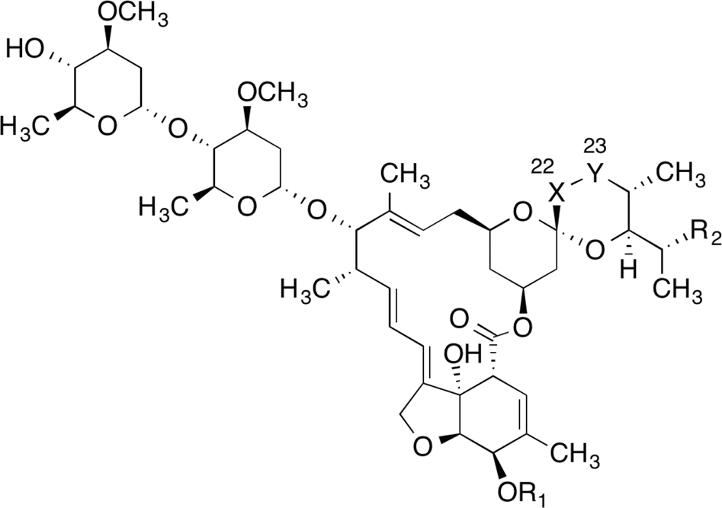
IVERMECTIN: Situation in LATAM 20 September – 2 October

Slide 2
IVERMECTIN ONLINE MEDIA IMPACTS 20 September to 2 October
Total impacts: 1.548
Reach: 17 million people
Monitored countries:
Argentina
Bolivia
Brazil
Chile
Colombia
Dominican Republic
Mexico
Peru
Venezuela

Slide 3
GENERAL ASPECTS
Argentina (390 articles)
Ivermectin is declared an efficient and save drug against COVID-19: An Argentine study suggests that ivermectin reduces COVID-19 viral load. The news talk in a very optimistic way about the study.
In Salta, ivermectin is already prescribed to prevent COVID-19 among health workers and other diseases patients.
Brazil (812 articles)
The Ministry of Health was planning to celebrate an event (“Día D”) on October 3 to distribut “covid kits” and provide guidance on early treatment to the population. These kits included ivermectin, hydroxychloroquine, azitromizin and chloroquine. Fortunately, the event was cancelled.
The Secretary of Health of Cuiabá was exonerated from his post, for alleged overpricing in the acquisition of the drug ivermectin.
Experts warn of self-medication in the Brazilian population. Ivermectin is among the used drugs.
Important to note: most of the Brazilian media keep highlighting that ivermectin efficiency against COVID-19 has not been proved.
Peru (181 articles)
Peru keeps treating COVID-19 patients with ivermectin, although its use has been questioned. Authorities are awaiting the results of three studies on its validity to decide whether to discontinue its use.
The authorities keep administering ivermectin as a preventive treatment in several regions of the country.

Slide 4
NEWS ON SUPPLIER CHAINS
Peru
Laboratories at the University in the Amazon Region are producing ivermectin to be distributed all along the country.
The Pharmacotechnics area of the University Hospital currently produces ivermectin.
The Cerro Verde company gave the Arequipa Regional Health Management a donation of laboratory equipment and supplies for the production of ivermectin.
Faculty of Chemical Engineering of UNA Puno received a distinction due to their task in producing ivermectin.
Argentina
Lafedar Laboratories has started manufacturing inhaled ibuprofen and ivermectin to treat COVID-19.
PLAMECOR (Planta de Medicamentos de Corrientes) has produced half a million six-milligram ivermectin tablets which are distributed among health workers in all Corrientes Municipalities.
Brazil
Two drug traffickers implicated in fraud for the distribution of ivermectin to hospitals.

Slide 5
LIST OF COUNTRIES
where ivermectin is being distributed massively
Argentina
The results of a study over 45 patients have boosted the implementation of ivermectin as a treatment against COVID-19.
Peru
Peru is still be the most active country in the administration of ivermectin to the population. The authorities are administering ivermectin both as treatment and prevention in several regions of the country: Casa Grande, Arequipa (Cayma), Tate, Loreto, Anco, Parcona.

Slide 6
NEWS ON ADVERSE EVENTS
Peru
Self-medication increases deaths linked to COVID-19 in Peru.

Slide 7
For more information: carolina.pozo@isglobal.org

