Slide 1
IVERMECTIN Press clipping 21 – 28 August

Slide 2
Press clipping 21 – 28 August
Total impacts: 898 (↓ 36,8 %)
Reach: 15,8 million people
Most Read – TOP 10
Médicos representam SC em encontro nacional sobre tratamento precoce de coronavírus
Bolivia intensifica búsqueda de contagiados de COVID-19
Automedicación y la falsa seguridad de que no habrá contagio
Corrientes investigará la eficacia de la ivermectina contra el coronavirus
La ositiva Seguros se une a la campaña “Arequipa Unida” para apoyar a afectados por el COVID-19
Dr. Luizinho: MP da Vacina: Resultado da união dos diferentes
Gobierno regional inaugura laboratorio para producción masiva de ivermectina
El nuevo amanecer
Sinaloa. Prevé Profeco multas de un millón de pesos por irregularidades en precios de hospitales
Elimina Cofepris trabas para producir medicamentos genéricos
Countries:
Argentina
Bolivia
Brazil
Chile
Colombia
Dominican Republic
Mexico
Peru
Venezuela
Find here the 50 most read impacts of the week

Slide 3
Hot topics
Argentina
The province of Corriente has started a clinical assay to evaluate the efficacy of ivermectin in COVID-19 patients. (Very abundant)
The Mexican’s Federal Commission for the Protection against Sanitary Risks determined that some drugs will be sold only with a prescription (ivermectin and hydroxychloroquine, among others).
Brazil
Bolsonaro defends early treatment protocol against COVID-19 which is based on the use of hydroxychloroquine.
The city of Rio Branco has signed a law that delivers Covid-19 kits to people who have symptoms of the disease through a prescription for treatment. The kit consists of medicines such as azithromycin, ivermectin and hydroxychloroquine.
Mexico
The Federal Commission for the Protection against Sanitary Risks (Cofepris) has eliminated barriers to the production of generic drugs, including ivermectin.

Slide 4
Hot topics
Peru
The National University of the Center of Peru starts the production of ivermectin in oral solution to be distributed to the patients in the university who are undergoing treatment against COVID-19.
Social media and fake news promote self-medication around the country.
Cusco tests 8,000 people and nearly 42% are COVID-19 positive. Each infected person received a kit containing ivermectin.
The North of Peru fights the advancement of COVID-19 with medical care and ivermectin-based treatment.
The region of Piura applied 150 rapid tests to carriers, passengers and the general public at the Covid Control post installed in a bus station. The detected patients received treatment with ivermectin, antibiotics, analgesics and vitamins to “strengthen the immune system”.

Slide 5
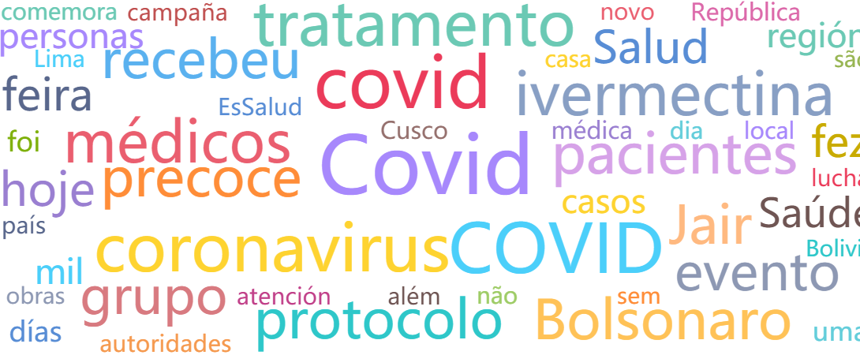
Analytics
Common words

Slide 6
Analytics
Audiences

Slide 7
For more information: carolina.pozo@isglobal.org

