Slide 1
IVERMECTIN Press clipping 14 – 21 August

Slide 2
Press clipping 14 – 21 August
Total impacts: 1,421 (↓ 27,9%)
Reach: 29,4 million people
Most Read – TOP 10
Bolsonaro asegura que es la “prueba viva” de la eficacia de la cloroquina
Cientistas brasileiros iniciam processo de patente para soro com plasma de cavalo: teste em humanos é próxima fase
Tratamientos contra la Covid-19, una carrera a la par de la vacuna
Bolsonaro diz que Anvisa vai facilitar acesso a medicamentos defendidos por ele
El camino largo y difícil
Soro produzido com plasma de cavalo tem anticorpo até 50 vezes mais potente contra a Covid-19, conclui pesquisa
Bolivia intensifica búsqueda de contagiados de COVID-19
Automedicación y la falsa seguridad de que no habrá contagio
Corrientes investigará la eficacia de la ivermectina contra el coronavirus
No hay evidencia de que el matarratón cure el COVID-19
Countries:
Argentina
Brazil
Colombia
Mexico
Peru
Find here the 50 most read impacts of the week

Slide 3
Hot topics
Argentina
The province of Corrientes will initiate studies to verify the effectiveness of ivermectin
Brazil
One of the largest health operators in Brazil, Hapvida is accused of pressuring doctors to prescribe medication without scientific proof (chloroquine) and advised against by several entities.
Bolsonaro says Anvisa will facilitate access to hydroxychloroquine and ivermectin. Anvisa denies it.
Brazilian scientists start patent process for serum with horse plasma: human testing is next phase.
Colombia
The “mata-ratón” plant is believed to contain ivermectin, thus curing COVID-19.
Former President Álvaro Uribe declares he takes ivermectin to treat COVID-19. The media deny the proven efficacy of the drug.
Remdesivir and interferon are being studied as possible treatments against COVID-19.

Slide 4
Hot topics
Mexico
Bolivia increases search for those infected with COVID-19.
Increase in diabetes and hypertension drugs.
Fake news in social media keep recommending ivermectin to treat COVID-19. The media deny the efficacy of the drug.
Peru
More than 1,000 citizens of the Kukama Kukamiria indigenous people will receive comprehensive health care and COVID-19 prevention measures. Sanitary material includes ivermectin.
A prison is already using ivermectin to treat COVID-19.
Cusco Hospital is massively producing ivermectin to administer it.

Slide 5
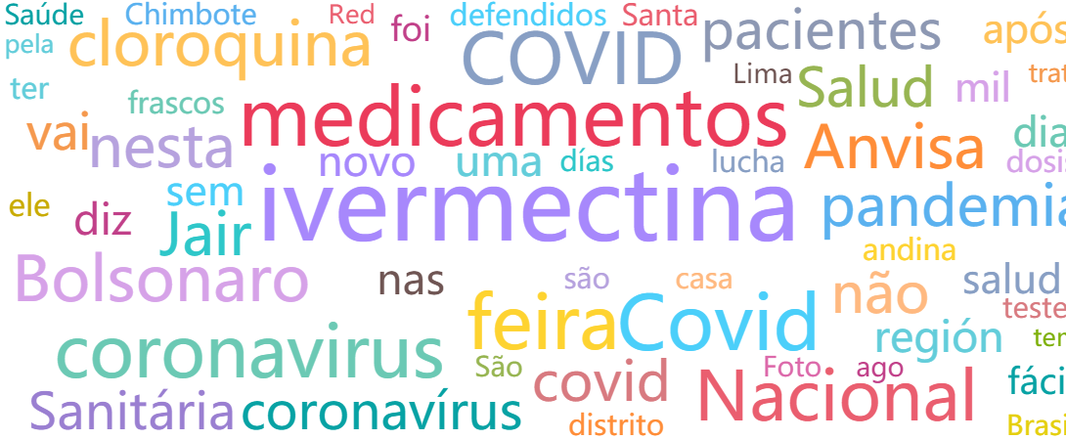
Analytics
Common words

Slide 6
Analytics
Audiences

Slide 7
For more information: carolina.pozo@isglobal.org

